Slide 1
Position Paper 101
Social Studies 10-1/20-1/30-1

Slide 2
General Outline
A position paper is an essay in which you take up a position or a STANCE… so you pick a SIDE
However, this does not mean it’s an OPINION paper…
It’s a paper in which you decide the position you are taking… and back it up with EVIDENCE (historical, contemporary, facts, etc)
An entire paper were you are trying to PROVE your POSITION
NOT tell the reader your opinion

Slide 3
Format
Introduction Paragraph
Body #1
Body #2
Body #3
Conclusion

Slide 4
Introduction (Source Analysis and Answer)
Be clear in your answer – Is the source correct or incorrect?
Breakdown the source
Explain any key terms or language used in the source
Introduce your argument
Discuss the perspective(s) reflected in the source

Slide 5
Paragraph 2/3/4 (Argument/Evidence/Examples)
Explain in detail your argument
Provide evidence to support your argument
Provide detailed examples, historical, and/or contemporary information to support your argument
Relate your argument back to the source
Use SS key terms to enhance your argument
DO x 3!

Slide 6
Rubric
Take a look at the rubric presented to you. This is the rubric used to mark PP’s at the diploma level. It’s used also at the 10-20-30 level’s in class.
Take a few minutes and look at the categories. How are they similar to a source analysis rubric? How are they different?
Highlight the keys words in each category i.e. what will differentiate the level you are at. What’s the different between a satisfactory and proficient?
KEEP THIS! Confused about why you only got an 11/20? Understand the weighting of each category!

Slide 7
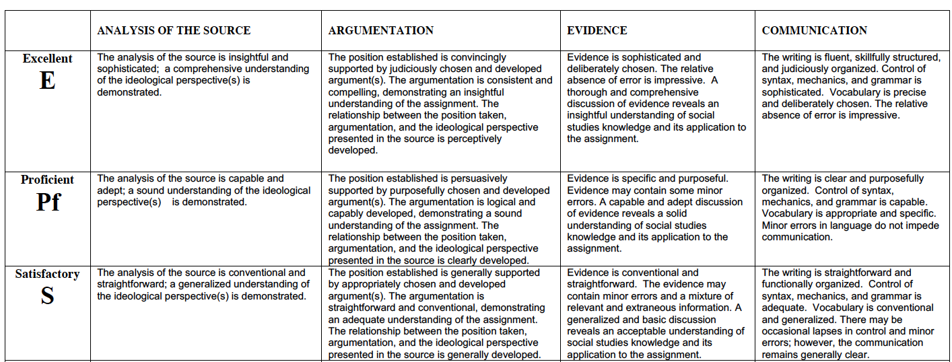
Introduction
Throughout
Body Paragraphs
Throughout

Slide 8
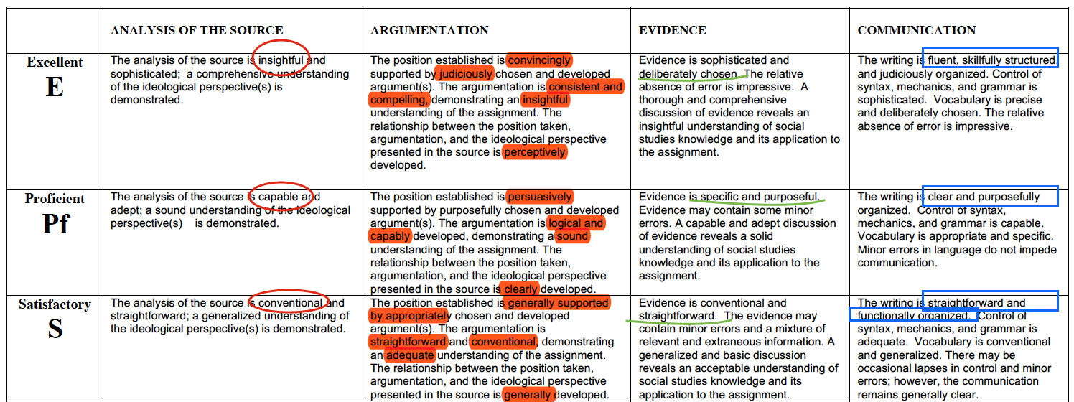
Introduction
Throughout
Body Paragraphs
Throughout

Slide 9
Practice Source
FLT is beneficial.
To what extent should we embrace the perspective reflected in the source?

Slide 10
Practice Source
What if…
I pulled some statistics off of PowerSchool
to solidify and backup my argument
I asked my friends what they thought
I remember when…
I had hockey 3 nights a week and was never able
To use my evenings to get work done. It really
Helped me stay on top of stuff
When I didn’t understand how to write a PP because
I had a hard time concentrating so I when to Ms.Gill’s FLT
and we went through it one-on-one
= Flexible Learning Time
I know that…
-> you have to sign up at least an hour before, but it’s best to sign up at the beginning of the week during connection block and teachers give you time to do that
FLT is beneficial.
To what extent should we embrace the perspective reflected in the source?
I agree because….
-> you can get work done
->you can ask for help
-> you can work on projects
= favorable or advantageous; resulting in good.

Slide 11
Practice Source Planning
Introduction Paragraph
What is FLT? Give some background information.
State your position: agree or disagree? Because… reason 1, 2, and 3
Body #1
Reason 1: It allows students to get extra help from their teachers, outside of class time. Explain in detail. Provide an example of a time where you were able to do this.
Body #2
Reason 2: It allows students to spend time during the school day catching up on course work, because of the amount of extra-curriculars most have. Explain in detail. Provide an example of a ti8me where it allowed you to use this time. Do you have any stats on this? How many students are involved in extra curriculars and how much after school time is spent on them?
Body #3
Reason 3: It allows time for collaboration between students who might not be able to meet outside of school hours. Provide reasons for why collaboration is important.
Conclusion
What did you tell me? Assume the reader is very forgetful, and remind them of all of your arguments again.
Remember, summarize not repeat!

Slide 12
Analysis of the Source
Satisfactory = FLT is a block during the day that students get time to work on homework.
Proficient = Flexible Learning Time (FLT) is a regular block in the school day where students sign up for one of their current teachers, go to that classroom, and use their time how they best see fit.
Excellent = Flexible Learning Time (FLT) is a regular block in the school day where students choose one of their current teachers, sign up for that classroom (ahead of time), and use their time in whichever way they best see fit contributing to meeting their needs that day. FLT was introduced because… FLT occurs on…

Slide 13
Argumentation
Satisfactory = FLT is beneficial and students should use it wisely if they are worried about getting work done.
Proficient = FLT is beneficial because it creates flexible opportunities for students to meet their academic needs.
Excellent = FLT is beneficial because it creates flexible opportunities for all students to get the assistance and guidance they require to meet their goals FLT is centered on student choice, therefore creating an environment where students can become independent and be accountable for their own success.

Slide 14
Evidence
Satisfactory = FLT works because students marks are going up and they are less stressed out.
Proficient = FLT is working because the reports pulled off of PowerSchool indicate that --% of the student population … The Wellness Centre has also shared that there are less students coming to them stressed out about their coursework.
Excellent = There are multiple indicators highlighting the benefits of FLT. The attendance reports pulled from PowerSchool indicate that… The Wellness Center shared that… Parents have outlined that… Student conversations prove that… Academic reports…

Slide 15
Communication
Satisfactory = FLT is beneficial because it gives students time to catch up on work.
Proficient = FLT is beneficial because it allows for students to get extra help from their teachers, catch up on homework that might be missed due to extra curriculars, and collaborate with others.
Excellent = FLT is beneficial because it embeds time into the school day during which students can get extra help and clarification from their teachers, get a head start on homework for the evening they might miss due to extracurriculars, and allows them to collaborate with peers on group projects without the difficulties that might arise from arranging rides.

